Slide 1

Chapter 1
Digital Design
Digital Systems and Binary Numbers
Tutor: Haseeb Rehan Aziz
Spring 2013
UET Taxila Subcampus Chakwal

Slide 2
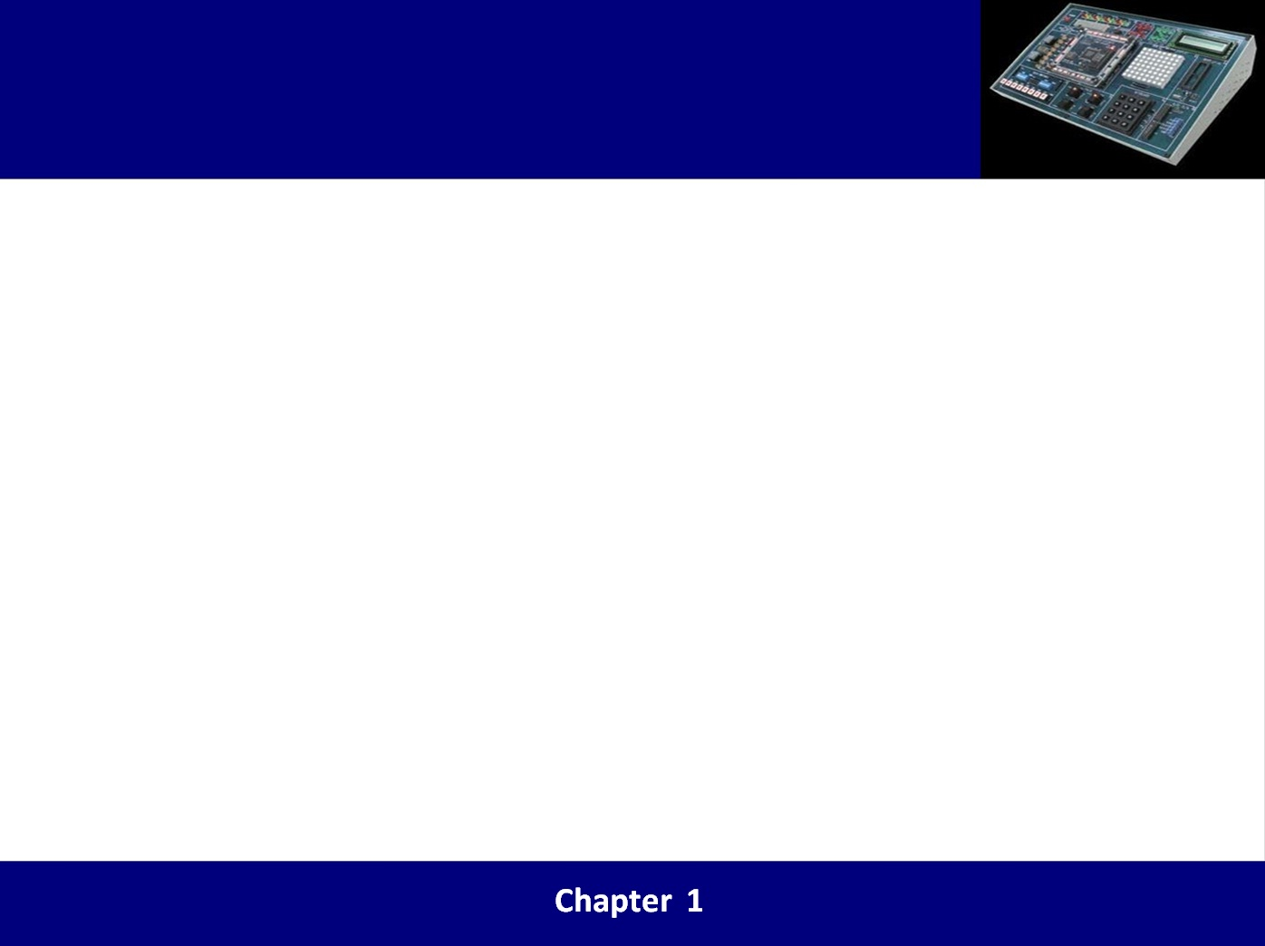
Lecture 1 review
Number systems
Binary, Octal and Hexadecimal number systems
Binary to decimal conversion
Decimal to binary conversion
Conversion of integral and fractional part

Slide 3
Overview
Digital & computer systems
Information representation-signals
Signal example over time
Signal physical quantity – voltage
Complements
Signed binary numbers
Binary numbers and binary coding
Binary codes
Binary storage and registers
Binary logic

Slide 4
1. Digital & computer systems
Takes a set of discrete information inputs and discrete internal information (system state) and generates a set of discrete information outputs.
Discrete
Discrete
Inputs
Information
Processing
Discrete
System
Outputs
System State

Slide 5
Digital system example
A Digital Counter (e. g., odometer):
Count Up
0
0
1
3
5
6
4
Reset
Inputs: Count Up, Reset
Outputs: Visual Display
State: "Value" of stored digits

Slide 6
2. Information representation - Signals
Information variables represented by physical quantities.
For digital systems, the variables take on discrete values.
Two level, or binary values are the most prevalent values in digital systems.
Binary values are represented abstractly by:
  digits 0 and 1
  words (symbols) False (F) and True (T)
  words (symbols) Low (L) and High (H)
  and words On and Off.
Binary values are represented by values or ranges of values of physical quantities

Slide 7
3. Signal examples over time
Time
Continuous in value & time
Analog
Digital
Discrete in value & continuous in time
Asynchronous
Synchronous
Discrete in value & time

Slide 8
4. Signal physical quantity : Voltage

Slide 9
Task – Decimal to Binary
Convert the decimal number with both integer and fraction parts to binary form.
……..?

Slide 10
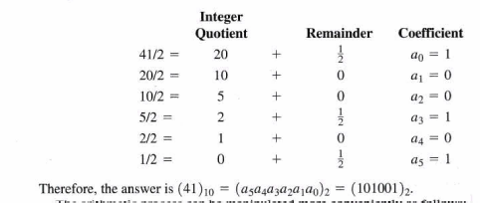
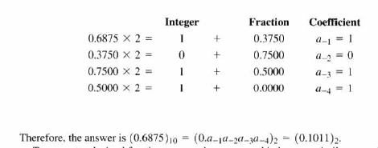
Task – Decimal to Binary
Integer part
Fractional part

Slide 11
5. Complements
Complements are used in digital computers to simplify the subtraction operation and for logical manipulation
There are two type of complements for each base-r system,
(1) r’s complement (radix complement)
(2) (r-1)’s complement (diminished radix complement)
Note: r’s and (r-1)’s is 2’s ,1’s complement in binary
and 10’s ,9’s complement in decimal numbers.

Slide 12
5. Complements
r’s complement
The r’s complement of an n-digit number N in base r is defined as,
For example ,2’s complement of 101 is,
r=2 , n=3 ,N=101
1000-101=011
is a binary number that consist of a 1 followed by n 0’s
The quick way of finding 2’s complement is to leave first least significant 1 with 0’s on right side and inverting all other bits

Slide 13
5. Complements
(r-1)’s complement
The (r-1)’s complement of an n-digit number N in base r is defined as,
In binary ,it will be 1’s complement
For example 1’s complement of 101 is
r=2 ,n=3 and N=101
111-101=010
Other way of finding 1’s complement is to invert all the bits

Slide 14
Subtraction with complements
5. Complements
The subtraction of two n-digit unsigned numbers M-N in base r can be done as follow,
Add the minuend M to the r’s complement of the subtrahend N.
If M is greater than N , the sum will produce end carry , which can be discarded.
If M is less than N ,the sum does not produce an end carry. So to obtain the answer take the r’s complement of the sum and place negative sign in front

Slide 15
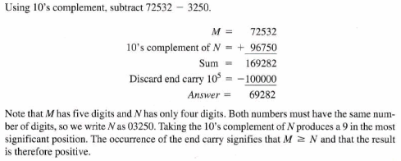
Example 1.5

Slide 16
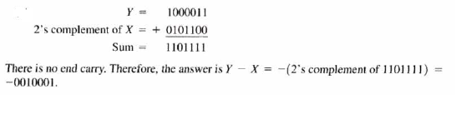
Example 1.7 (b)

Slide 17
6. Signed binary numbers
As computer represent everything in binary digits and to represent the sign with the bit placed in the leftmost position of the number .So sign bit “0” for +ive and “1”for -ive.
For example “01001” represent “+9” in both signed and unsigned binary.
What will be the unsigned and signed binary of “11001” ?

Slide 18
6. Signed binary numbers
There are three different types of signed binary conventions,
  Signed magnitude convention
  Signed 1’s complement convention
  Signed 2’s complement convention
As an example , consider number +9 and its 8-bit binary representation is “00001001” but there are three different ways to represent -9 with eight bits:
10001001 “signed-magnitude representation”
11110110 “signed-1’s-complement representation”
11110111 “signed-2’s-complement representation”

Slide 19
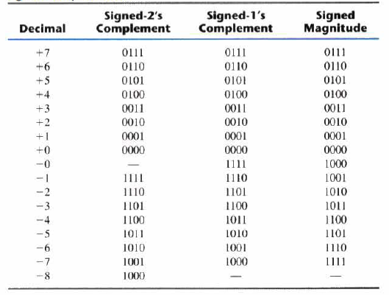
6. Signed binary numbers

Slide 20
6. Signed binary numbers
Sign Extension
Converting an n-bit complement number equivalent m-bit number (m>n),we must append (m-n) copies of sign bit to the left of the given number . e.g. “101” as “1101” .
If (m<n) then (n-m) leftmost bits of the given number are discarded. However the result is valid only if all of the +ive discarded bits are same as the sign bit of the result . e.g. “11101” as “101” .

Slide 21
6. Signed binary numbers
Over flow
The term overflow generically defined as , any system gets something more than its capacity.
This problem mostly occur in computing when computation starts with n-bits numbers and ends up with n+1 bits.
As an example , the addition of binary “10” and “11” results (?) if we have 2-bits to hold the sum.

Slide 22
6. Signed binary numbers
Arithmetic Addition
The addition of two numbers in the signed-magnitude system follows the rules of ordinary arithmetic.
The sum will always be greater than both “addend” and “augent”
The sum require extra bits in some cases and may generate overflow error
When there is “overflow” the carry coming into or out of the sign bit is different.

Slide 23
6. Signed binary numbers
The examples of binary addition are
Carries 0 0
Augend 01100 10110
Addend + 10001 +10111
Sum 11101 ------
Note: The 0 is the default Carry-In to the least significant bit.

Slide 24
6. Signed binary numbers
Arithmetic Subtraction
Subtraction of the two signed binary numbers are as follows,
Take the 2’s complement of the subtrahend and add it to the minuend
A carry out of the sign-bit position is discarded.
The difference of two numbers will be less than either number.
The result will not includes extra bit and subtraction is simply addition of “minuend” and 2’s complement of “subtrahend”

Slide 25
6. Signed binary numbers
The examples of binary subtraction are
Borrows 0 0
Minuend 10110 10110
Subtrahend - 10010 - 10011
Difference 00100 --------
Notes: The 0 is a Borrow-In to the least significant bit. If the Subtrahend > the Minuend, interchange and append a – to the result.

Slide 26
6. Signed binary numbers
Binary Multiplication

Slide 27
7. Binary numbers and binary coding
Flexibility of representation
  Within constraints below, can assign any binary combination (called a code word) to any data as long as data is uniquely encoded.
Information types
  Numeric
    Must represent range of data needed
    Very desirable to represent data such that simple, straightforward computation for common arithmetic operations permitted
    Tight relation to binary numbers
  Non-numeric
    Greater flexibility since arithmetic operations not applied.
    Not tied to binary numbers

Slide 28
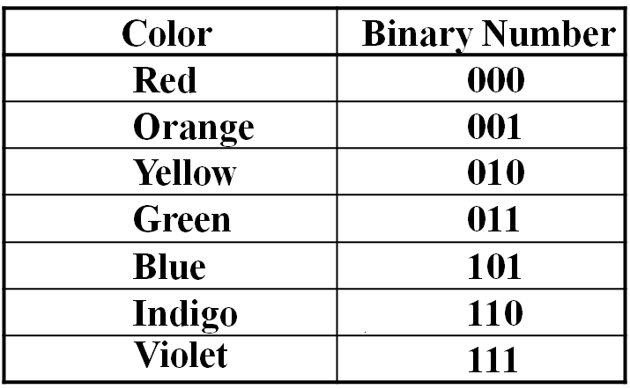
7. Binary numbers and binary coding
Non-numeric Binary Codes
Given n binary digits (called bits) , a binary code is a mapping from a set of represented elements to a subset of the 2^{n} binary numbers.
Example: A
binary code
for the seven
colors of the
rainbow
Code 100 is
not used

Slide 29
8. Binary codes
The set of bit string used to represent a set of objects is called “code”
Each such bit string in the set is called a “code word”
The minimum number of bits required to code distinct quantities in “n”. so each element is assigned a unique binary bit combination.

Slide 30
8. Binary codes
Binary Coded Decimal (BCD)
The BCD code is the 8,4,2,1 code.
8, 4, 2, and 1 are weights
BCD is a weighted code
This code is the simplest, most intuitive binary code for decimal digits and uses the same powers of 2 as a binary number, but only encodes the first ten values from 0 to 9.
Example: 1001 (9) = 1000 (8) + 0001 (1)
When binary sum is greater than or equal to “1010”,the result is invalid
To make invalid sum in to valid add 0110 (binary) in it.

Slide 31
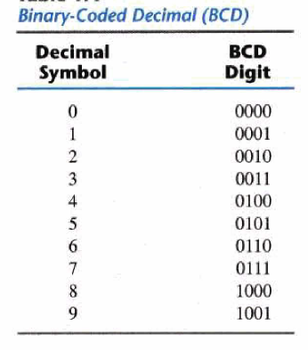
8. Binary codes
How many “invalid” code words are there?
What are the “invalid” code words?

Slide 32
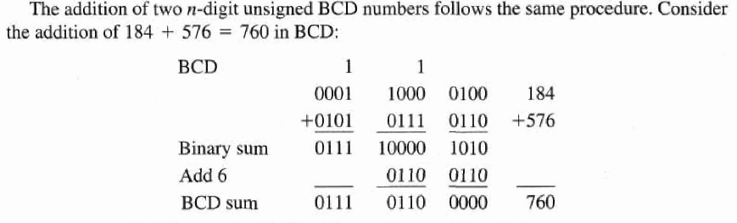
8. Binary codes
BCD addition

Slide 33
Gray code
8. Binary codes
Sometimes it may be necessary for a designer to avoid a number system ,where are more bits change their values between successive numbers
Gray code has the unique property that the successive code words differ only in one bit position
The typical application is in representation of analog data by continuous change in the angular position of a shaft

Slide 34
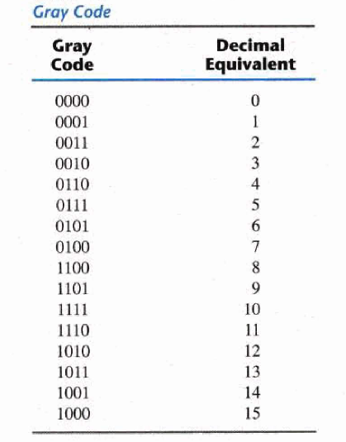
Gray code
8. Binary codes

Slide 35
8. Binary codes
ALPHANUMERIC CODES - ASCII Character Codes
American Standard Code for Information Interchange
This code is a popular code used to represent information sent as character-based data. It uses 7-bits to represent:
  94 Graphic printing characters.
  34 Non-printing characters
Some non-printing characters are used for text format (e.g. BS = Backspace, CR = carriage return).Other non-printing characters are used for record marking and flow control (e.g. STX and ETX start and end text areas).

Slide 36
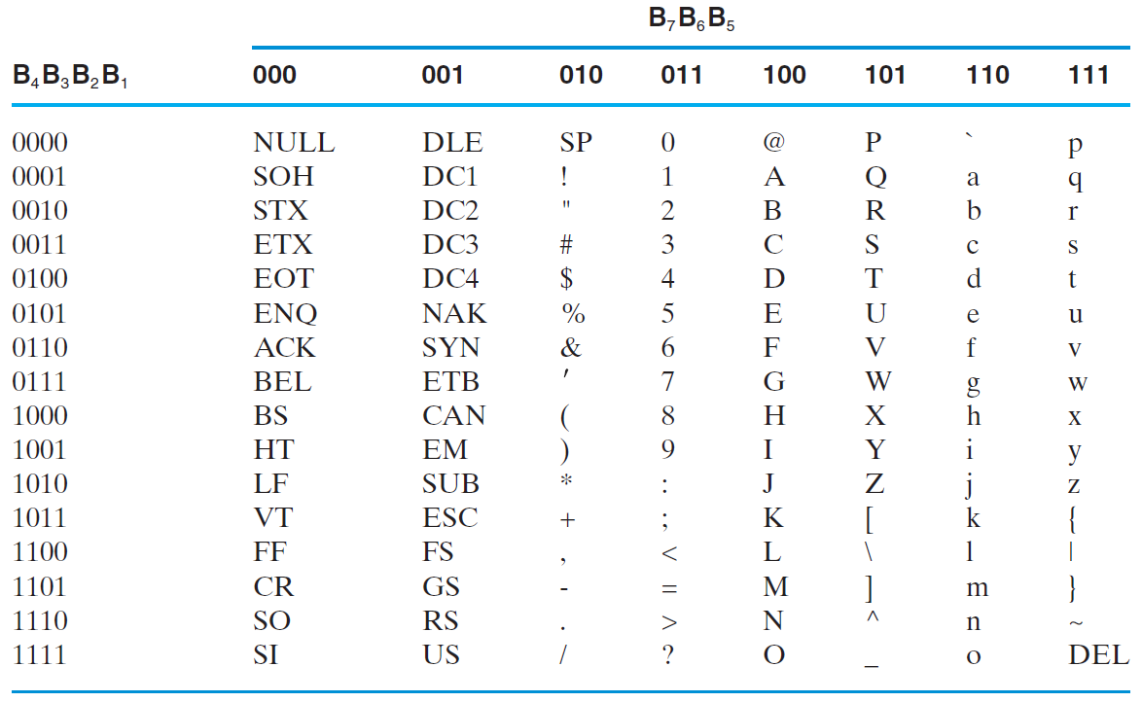
8. Binary codes
ALPHANUMERIC CODES - ASCII Character Codes

Slide 37
8. Binary codes
ASCII Properties
Digits 0 to 9 span Hexadecimal values 30H
to 39H
Upper case A
-
Z span 41H
to 5AH
Lower case a
-
z span 61H
to 7AH
.
Lower to upper case translation (and vice versa)
occurs by
flipping bit 6
Delete (DEL) is all bits set,
a carryover from when
punched paper tape was used to store messages

Slide 38
8. Binary codes
UNICODE
UNICODE extends ASCII to 65,536 universal characters codes
  For encoding characters in world languages
  Available in many modern applications
  2 byte (16-bit) code words
  See Reading Supplement – Unicode on the Companion Website http://www.prenhall.com/mano

Slide 39
8. Binary codes
PARITY BIT Error-Detection Codes
Redundancy (e.g. extra information), in the form of extra bits, can be incorporated into binary code words to detect and correct errors.
A simple form of redundancy is parity, an extra bit appended onto the code word to make the number of 1’s odd or even. Parity can detect all single-bit errors and some multiple-bit errors.
A code word has even parity if the number of 1’s in the code word is even.
A code word has odd parity if the number of 1’s in the code word is odd.

Slide 40
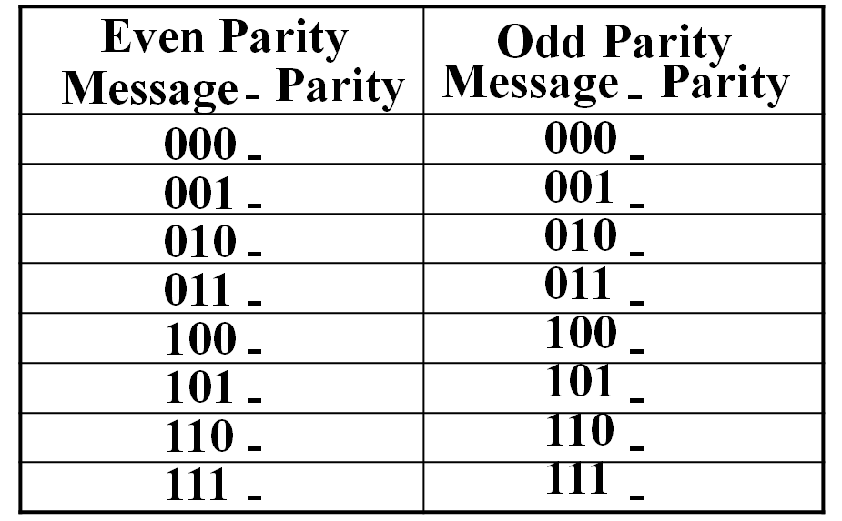
8. Binary codes
4-Bit Parity Code Example
Fill in the even and odd parity bits:
The codeword "1111" has even parity and the codeword "1110" has odd parity. Both can be used to represent 3-bit data.

Slide 41
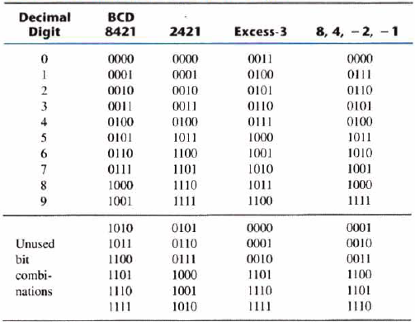
DECIMAL CODES - Binary Codes for
Decimal Digits
There are over 8,000 ways that you can chose 10 elements from the 16 binary numbers of 4 bits. A few are useful:

Slide 42
9. Binary storage and registers
Binary cell is a device that possess two stable states and is capable of storing one bit of information
The information stored in a cell is 1 when stable state is “1” and “0” in other case
The output of the cell is a physical quantity, that distinguish between two states
“Register” is a group of binary cells

Slide 43
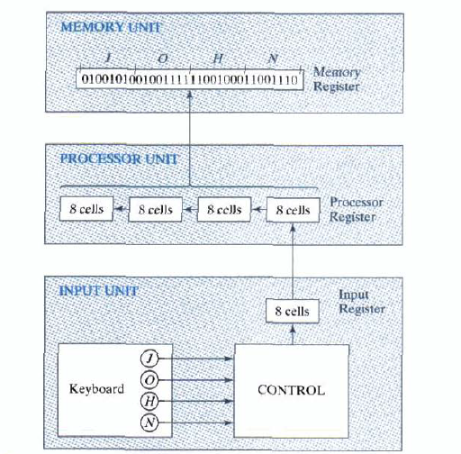
9. Binary storage and registers
A “Register Transfer” operation consist of a transfer of binary information from one set of register into another set of register

Slide 44
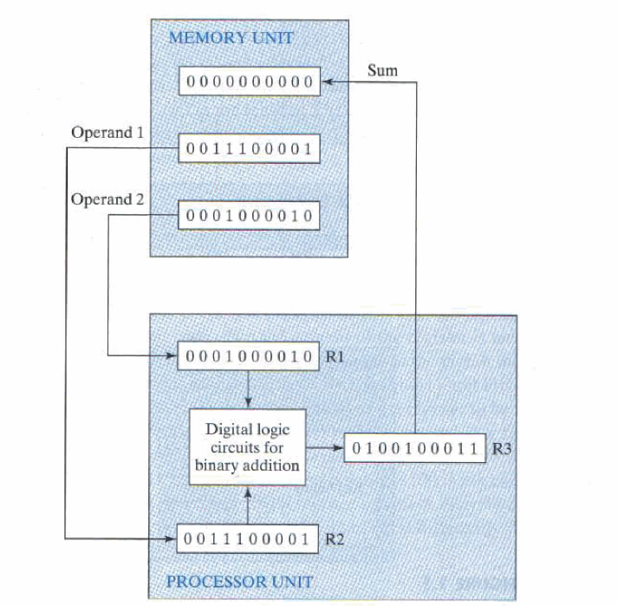
Example : Binary Information Processing

Slide 45
10. Binary logic
Binary logic deals with operation perform on two discrete values that assume logical meanings
Basic logical operation can be AND,OR and NOT
“Truth table” is a table lists the output values for all possible combinations of the input values
Digital electronic circuit corresponding to the logical functions are known as logic gates or simply gates

Slide 46
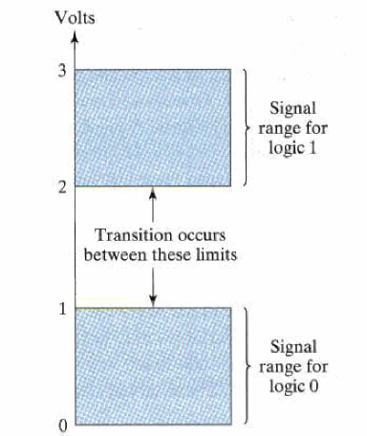
10. Binary logic
Logic “1” or logic “0” are represented physically by two separate voltage levels.
In practice , each volt level has an acceptable range .The intermediate region is crossed only in state transition.

Slide 47
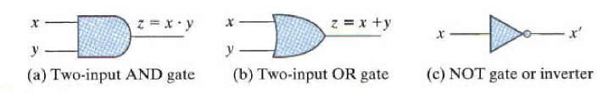
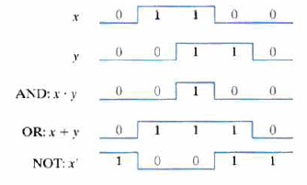
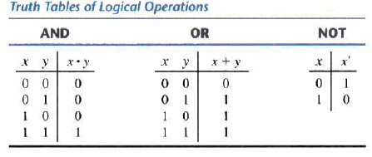
10. Binary logic
Logic Gates
Truth tables
Logic gates waveforms

Slide 48
Summary
Digital system and information representation
Complements operation and how various forms are used in computing
Key difference of binary conversion and coding
Variety of coding techniques BCD ,Excess- 3,ASCII,UNICODE .etc.
Binary cell, register and application of register transfer in information processing in computation.
Binary logic and its voltage level relationship.
logic gates symbols for 2-inputs,truth table and waveforms

Slide 49
Home task
Chapter 1 exercise
Question 1.3, Question 1.7, Question 1.10,
Question 1.11, Question 1.14, Question 1.15, Question 1.22, Question 1.23, Question 1.25, Question 1.35, Question 1.36

